Slide 1

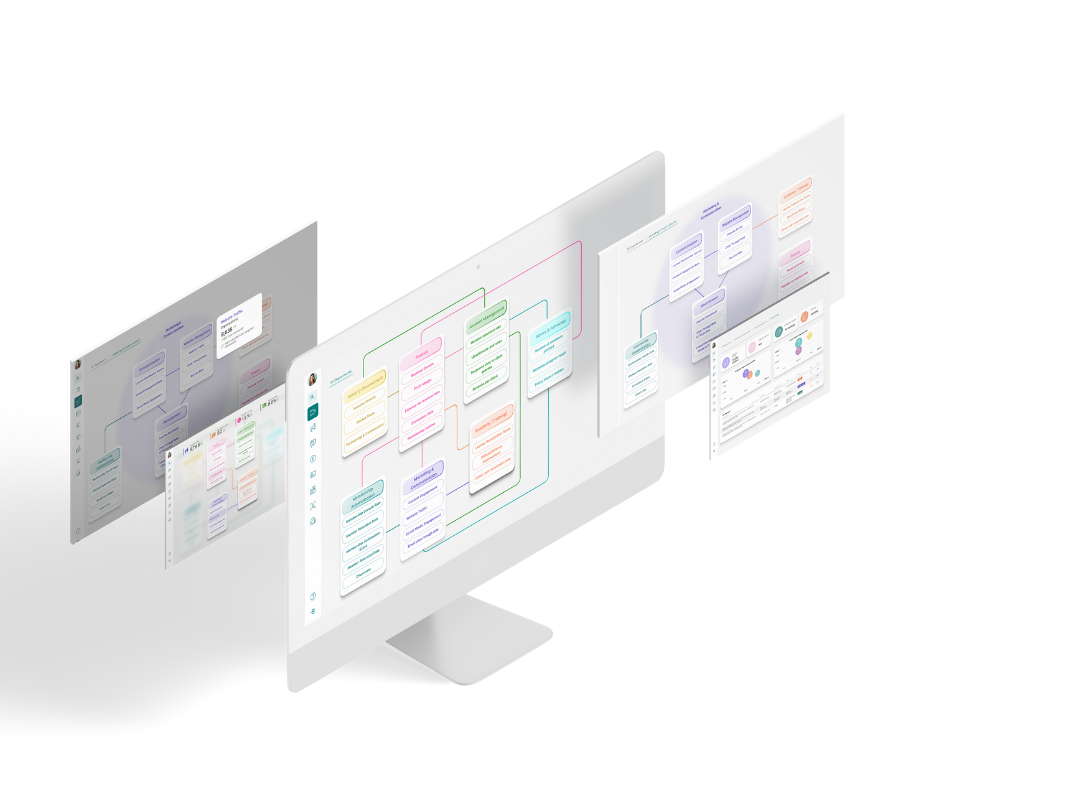
SEMESTER 5 - INTERNSHIP
IMPROVING DATA VISUALISATION
Ivayla Nekezova
Notes:
Hello everyone. Today I am going to present my semester 5 internhsip project about Improving data visualisation.

Slide 2
Company Introduction
Assignemnt Overview
Design Challanges and Solutions
Table of Contents
Project Phasing
1. Plan
Demo
2. Research
Advice to stakeholders
3. Design
4. Develop
Questions
5. Test
6. Evaluate
Notes:
The contents of this presentation are:

Slide 3
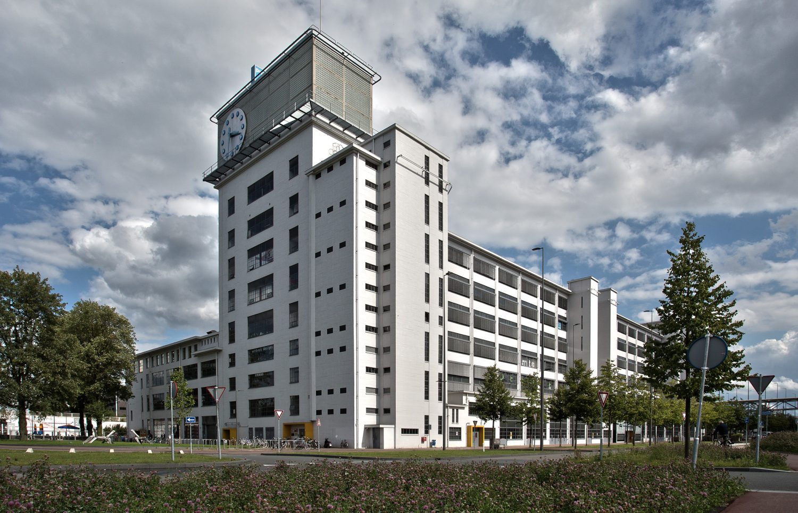

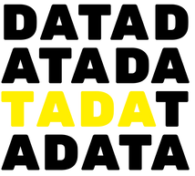
Company Introduction
Tada Solutions is data organisation company that:
• Specialises in data management and analytics
• Converts raw data into actionable insights
• Creates user-friendly data dashboards in PowerBI
• Focuses on enhancing data accessibility and user engagement for their clients
Collaboration:
Tada Solutions collaborates with Bankai, a digital stratey and design company, to combine data insights with user-centric design, delivering comprehensive and impactful digital solutions.
-
Notes:
I am intering at Tada Solutions which is

Slide 4
ASSIGMENT OVERVIEW
Methodology
-
OBJECTIVE
The project aims to enhance clients' understanding of data and its flow across company departments by creating improved data visualisation dashboards.
Objective
-
METHODOLOGY
Assignment Overview
Waterfall Methodology: Sequential phases from Plan to Evaluate ensure structured progression.
DOT Framework and CMD Methods: Enhance project management and efficiency.

Slide 5
PROJECT PHASING
6
5
4
3
Evaluate
Assess outcomes and gather feedback for improvements.
Test
Conduct testing and address issues.
2
1
Develop
Incorporate the design into a high-fidelity prototype.
Design
Create sketches, wireframes and design concepts.
Research
Gather insights and requirements.
Plan
Define project goals, scope, and resources
Notes:
The project is structured into distinct phases and focuses, each associated with specific approaches:

Slide 6
PLAN PHASE
Gantt Chart Creation
Developed roadmap with milestones.
Ensured clear project execution.
Initial Background Research
Explored data vizualisation trends, AI forecasting, and design principles.
Guided project direction and decisions.
Establishment of Infrastructure
Set up Git, Microsoft Teams, Figma.
Facilitated collaboration and prototyping.
01
Notes:
First, I created a Gantt chart to outline the project timeline with clear milestones for each phase. This ensured a structured and timely project execution.
I began with background research, exploring the latest trends in data visualization, AI forecasting, and design principles.
This research provided a solid foundation and guided the project's direction and decisions.
Then, I set up essential tools like Git and Notion keeping all documentation organized and easily accessible,
Microsoft Teams for communication, and Figma for design. This infrastructure was crucial my workflow.

Slide 7
RESEARCH PHASE
Primary Research
-
PRIMARY RESEARCH
User Preferences:
visual consistency
contextual information
predictive analytics
User Pain Points:
lack of context
overwhelming complexity
Resaerch Phase
-
02
Project Phasing
Notes:
Next, I conducted primary research to understand user needs:

Slide 8
SECONDARY RESEARCH
Secondary Research
Research Scope:
User Studies, Market Research, Usability Reports, Analysis of Existing Tools and Techniques, AI Forecasting Integration
Key Findings:
Effective dashboards feature clarity, intuitive navigation, and accessible data hierarchy.
Current tools like Power BI excel in data handling but offer limited developer customisation.
AI forecasting integration provides enhanced accuracy, automated insight and decision-making support, while facing challenges like data quality, model complexity, interpretability issues, and maintenance needs.
-
Resaerch Phase
-
02
Project Phasing
Notes:
I also reviewed existing studies and usability reports to supplement my primary findings. This included analyzing the current data visualization tools and techniques used by the company, identifying strengths, weaknesses, and areas for improvement.

Slide 9
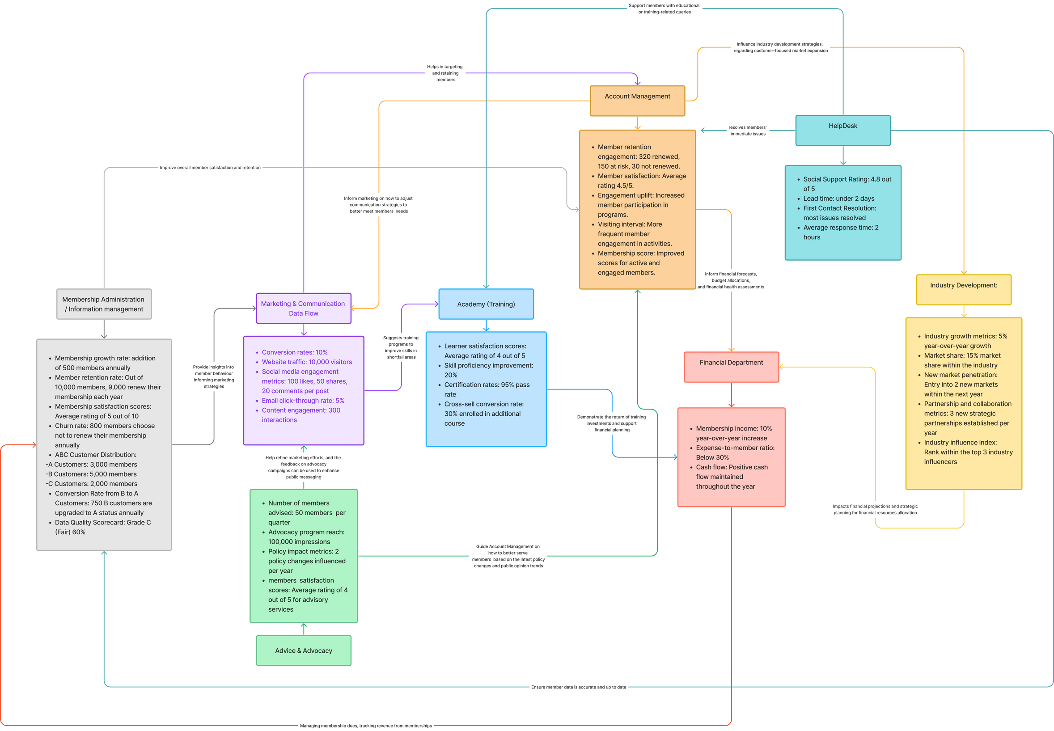
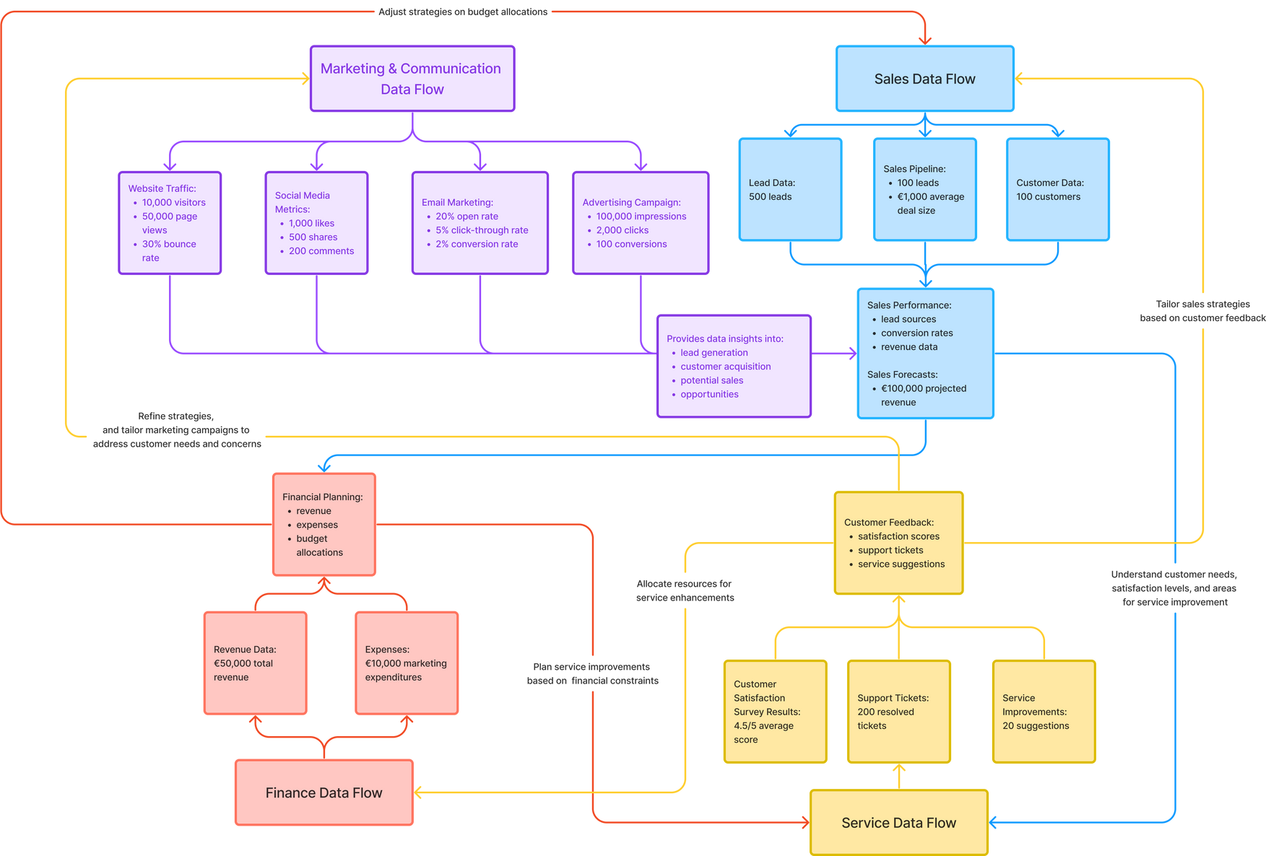
DESIGN PHASE
IDEATION
Created FigJam board for brainstorming and inspiration.
Explored metrics and visualisation ideas for each core department.
Refined based on feedback and real-life case study from Bouwend Nederland.
03
Notes:
In the Design Phase, I created a FigJam board to explore various ideas and concepts. The board served as an inspiration and brainstorming hub, containing key metrics, formulas, and visualizations relevant to each department.
Initially, I concentrated on the core departments such as marketing, sales, finance, and service. Understanding how different departments communicate and share data was crucial for optimizing business processes and decision-making.
After gathering these insights, I crafted an ideation design based on the connections between departments within a company. This involved creating a basic flowchart illustrating the relationships between (KPIs) of different departments.
With feedback from mentors, I refined the flowchart and incorporated a real-life case from the company 'Bouwend Nederland', a client of Tada Solutions.
Bouwend Nederland represents over 4300 construction companies in the Netherlands, advocating for industry interests and promoting innovation and sustainability through support services and training programs.

Slide 10
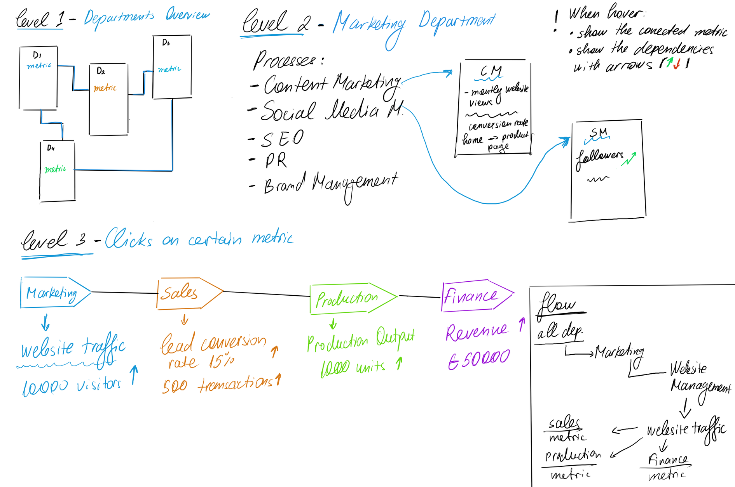
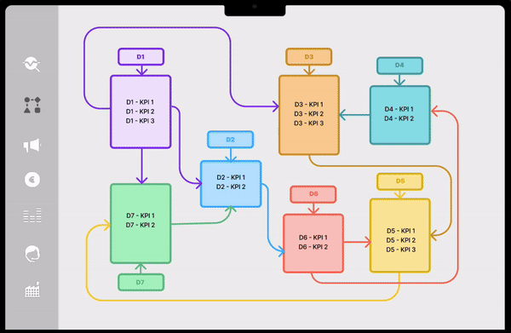
SKETCHES AND WIREFRAME
03
Notes:
Moving forward, I visualized my ideas through sketches and presented them during weekly meetings with my mentors. They validated the concept and encouraged me to continue refining it.
Subsequently, I translated the sketches into wireframes using Figma, adding animations to enhance the visual representation.

Slide 11
FEATURE PRIORITISATION
Feature Prioretisation
Kept Features:
AI Forecasting of projections.
Departments flowchart visualisation.
Removed Features:
Responsive Design for Mobile Devices.
Customisable Overview Page with Widgets.
Decision based on criticality, impact, and resource constraints.
-
03
Design Phase
Notes:
In order to effectively manage the project within the constraints of limited time, it was essential to prioritize features based on their criticality and potential impact. As a result, some features had to be removed to ensure a focused approach towards achieving the project's objectives.

Slide 12
DEVELOP PHASE
Presentation 2024
CONCEPTING
The concept involved developing a web portal with four interactive levels of data visualisation:
Level 1 - Departments Overview: Flowchart showing department relationships and top KPIs.
Level 2 - Department Processes: Detailed processes and KPIs within selected department.
Level 3 - Process Analytics Dashboard: Graphs tracking metrics over time for selected processes.
Level 4 - Advanced Analytics: In-depth insights including projections and impact assessments.
-
04
Thynk Unlimited
Notes:
In developing phase, I refined the concept through several mentor meetings.

Slide 13
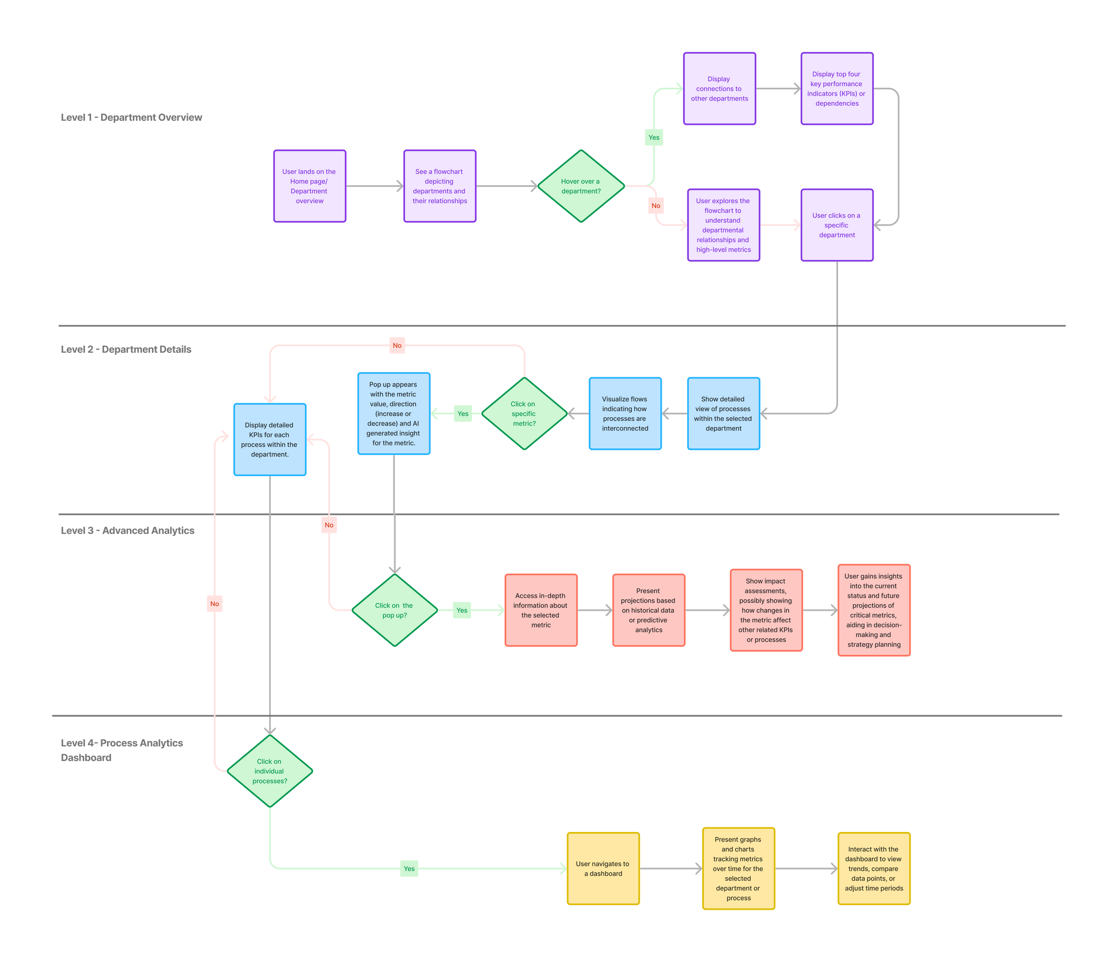
USER JOURNEY FLOW
-
04
Notes:
I consulted with Thijn, the senior UX/UI designer from Bankai. Thijn suggested creating a user flow to outline how users would navigate through the product. This step was crucial for establishing a clear and efficient user experience. Following Thijn's advice, I developed the main user flow, ensuring a logical progression through the product.
As you can see in the flowchart on the right I have put the product levels horizontally following how the user is going to navigate through the product with steps and if conditions.

Slide 14
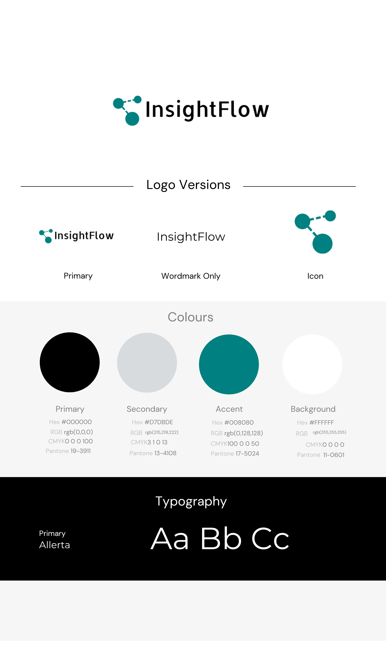
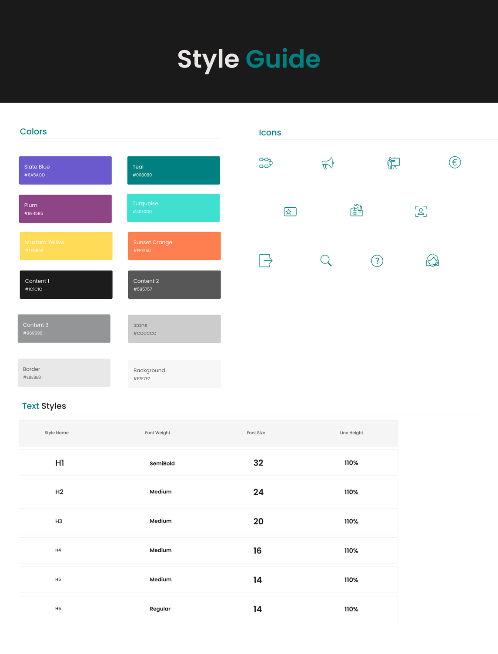
STYLE GUIDE AND BRANDING
-
04
Notes:
I choose a color palette and style guide focusing on aesthetics and accessibility, using a Color Blindness Simulator to ensure inclusivity.
I established a name and logo for the product, adding professionalism and identity.

Slide 15
TEST PHASE
USABILITY TESTING
Results: Overall positive feedback on login and onboarding processes, highlighting their clarity and effectiveness in guiding users through the system.
Improvements: Enhanced clarity in department and metric differentiation. Navigation was generally good but with suggestions for refinement of the breadcrumbs.
-
05
Notes:
During the test phase, I conducted usability testing and A/B testing to evaluate the prototype's usability.

Slide 16
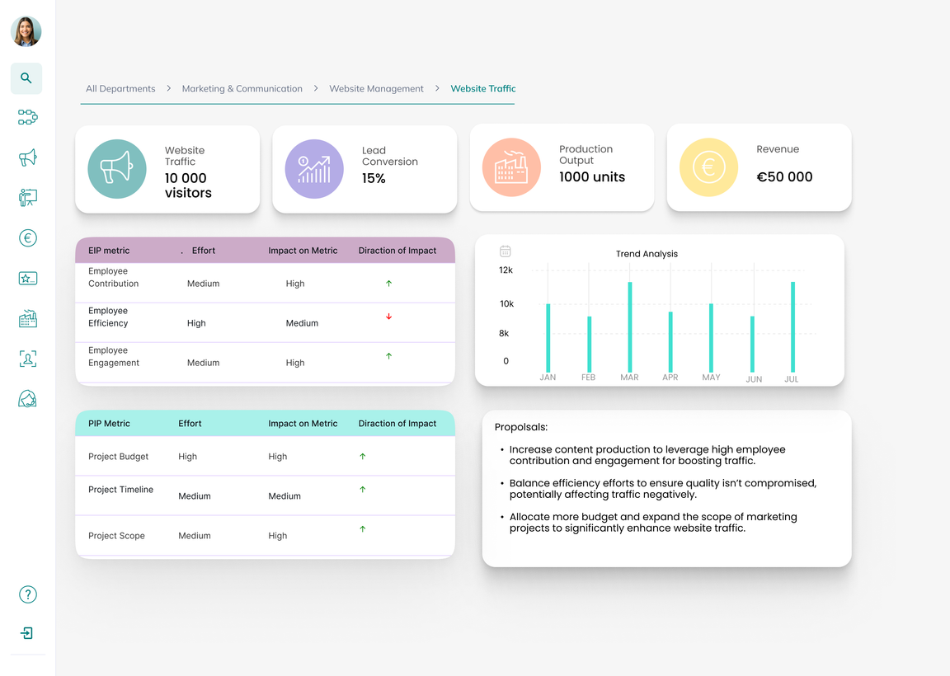
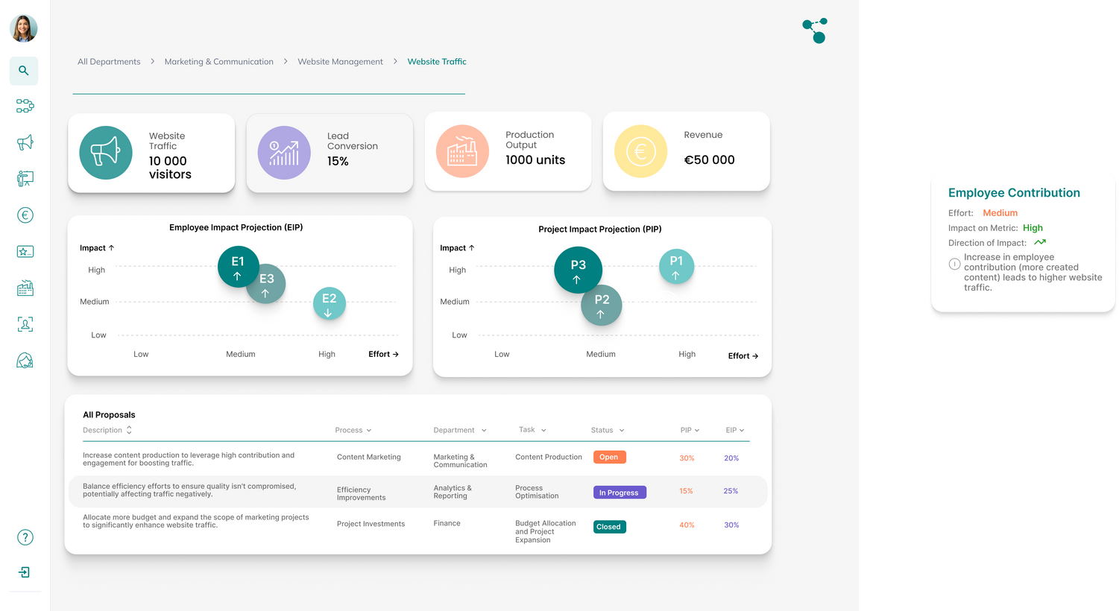
-
A/B TESTING
Results: Variant B showed preference due to its enhanced visual appeal and intuitive data interpretation compared to Variant A's structured but less visually engaging presentation.
Improvements: Introduced visual elements such as bubble charts and proposal tables, aiming to improve visual appeal and data clarity.
A
B

Slide 17
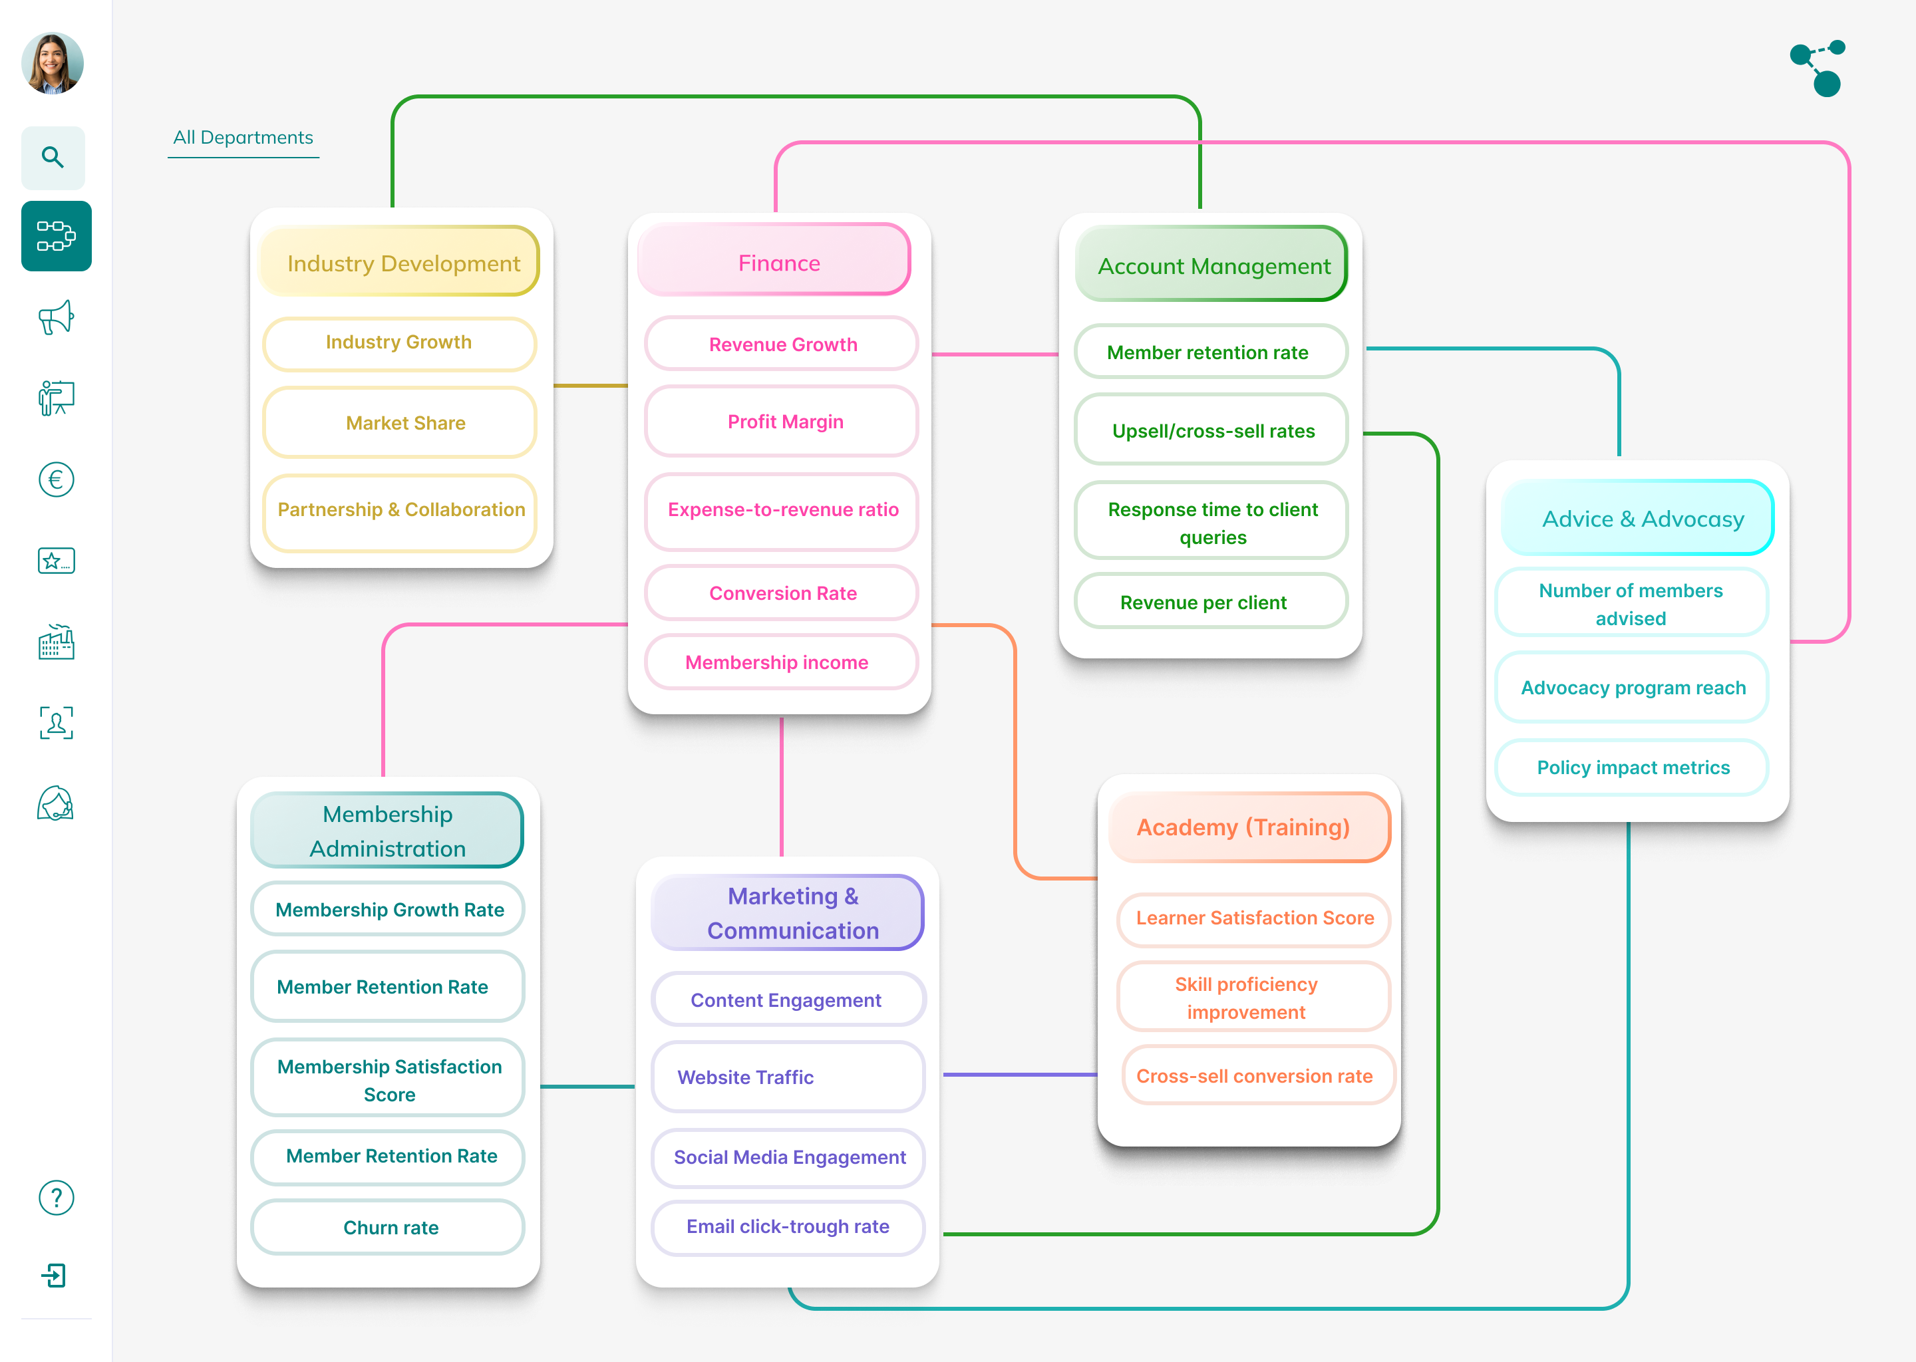
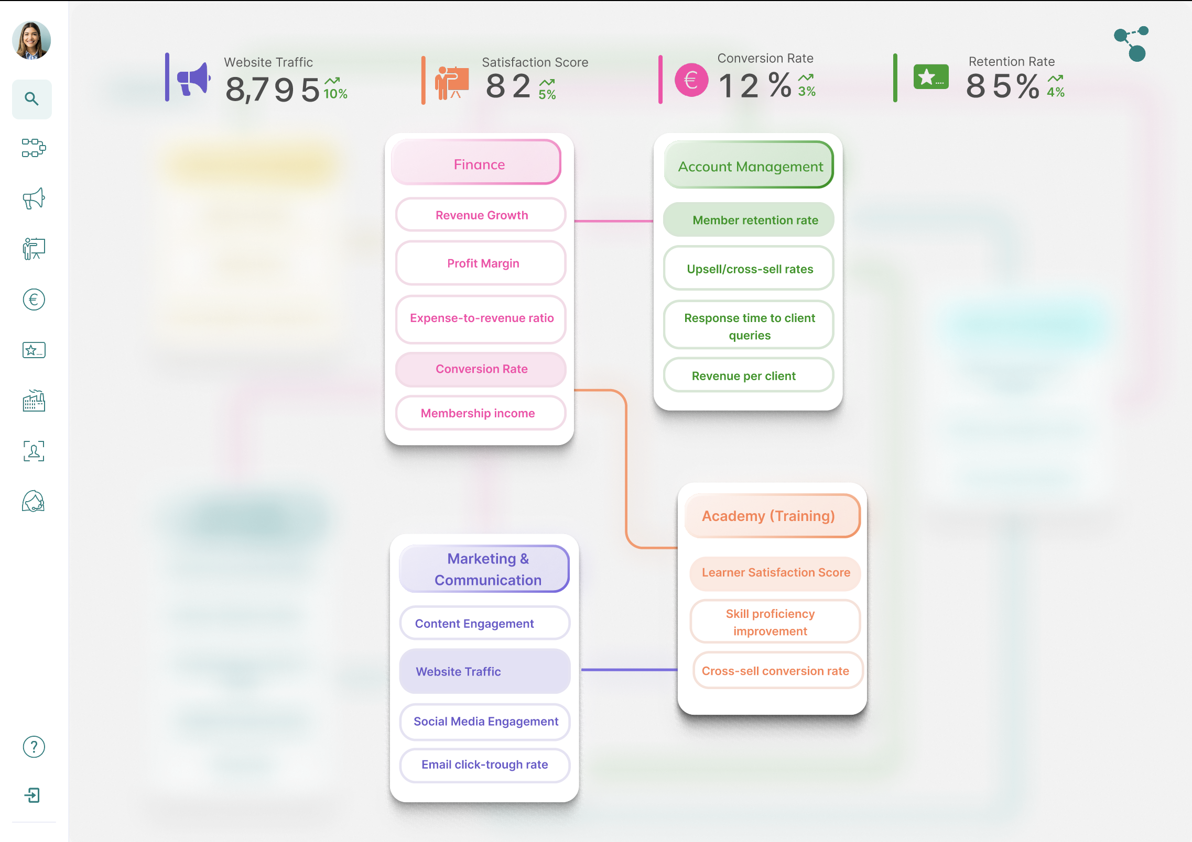
ITTERATIONS
Notes:
Here you can see some of my iterations with enhancements in visual design, interactivity, and data presentation.
This is the departemnts Overview Page
adding hover animation

Slide 18
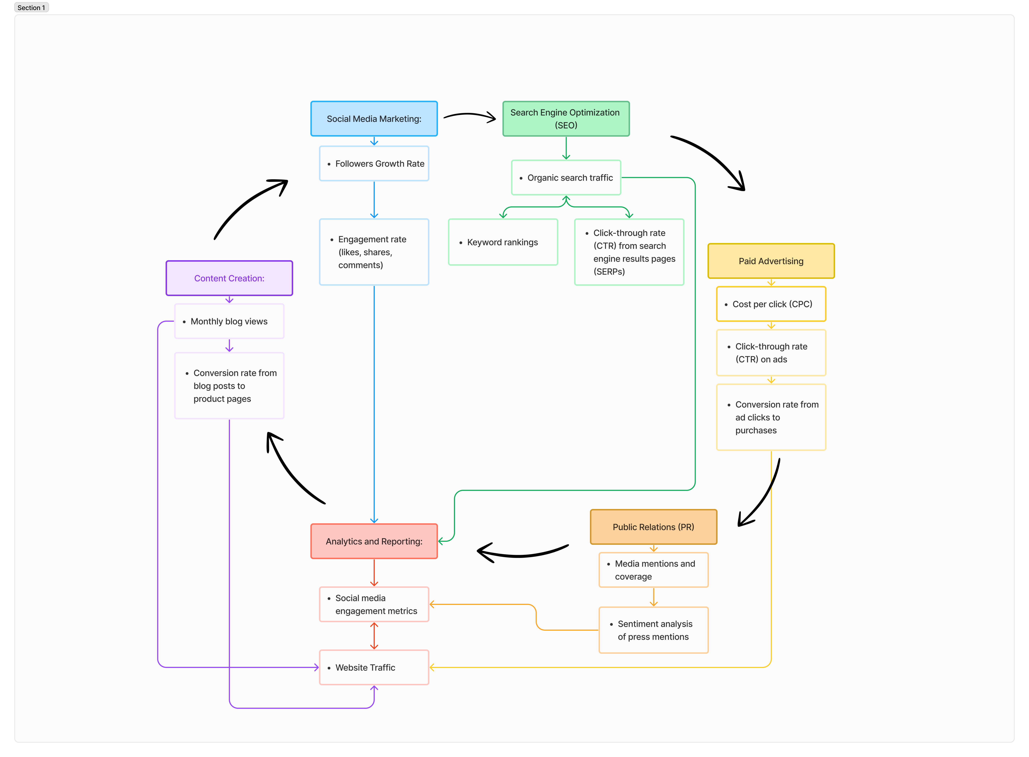
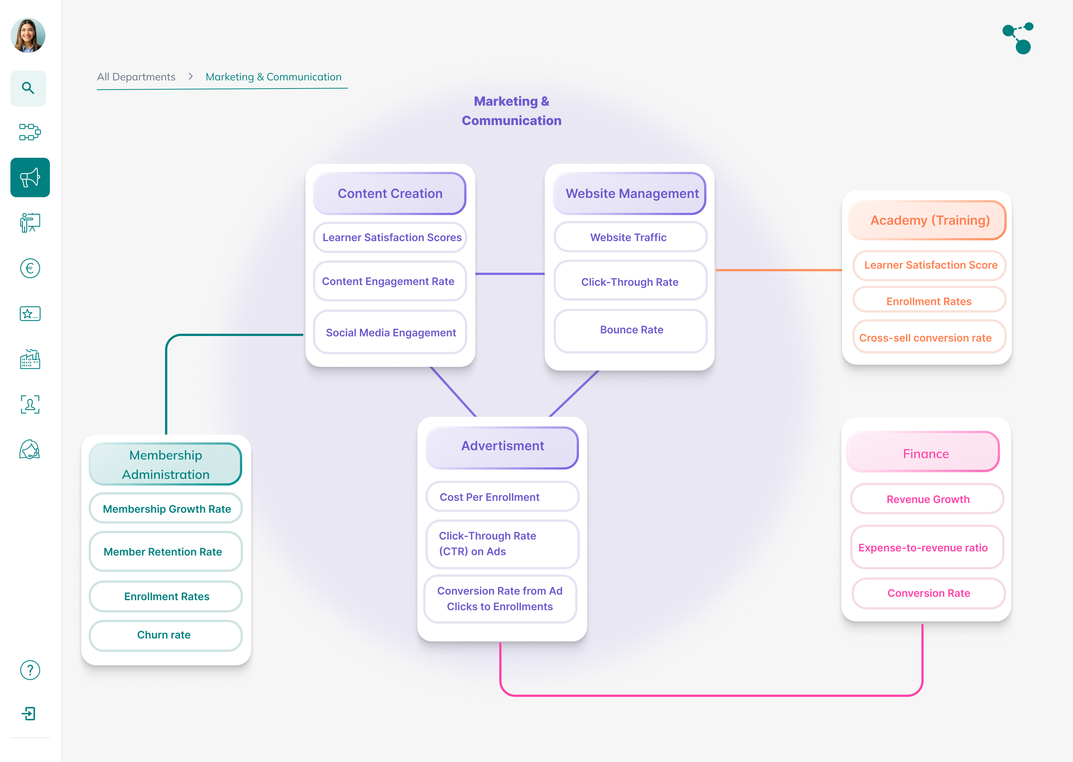
ITTERATIONS

Slide 19

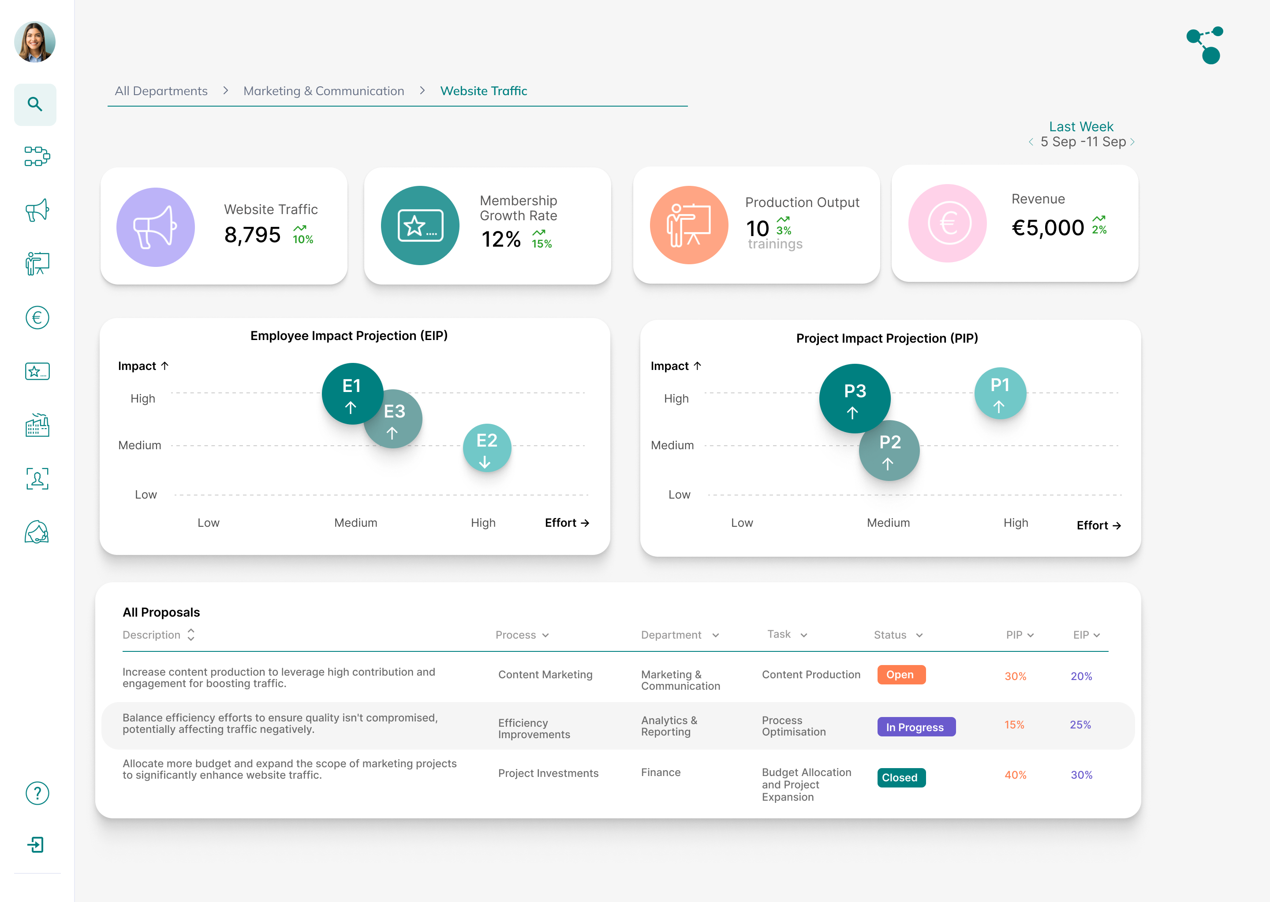
ITTERATIONS

Slide 20
Presentation 2024
EVALUATE PHASE
-
Engaged stakeholders for feedback on prototypes.
Implemented enhancements based on feedback: animations, interactive elements.
Finalised the Prototype after iterative user testing.
Concluded with self-reflection on project outcomes and improvements.
06
Thynk Unlimited

Slide 21
DESIGN CHALLENGES AND SOLUTIONS
Balancing Data Density with Clarity:
Maintained clean main view with strategic hover pop-ups for detailed insights, avoiding clutter.
Integrating EIP and PIP:
Incorporated bubble charts with pop-ups to present Employee Impact Projections and Project Impact Projections clearly and insightfully.
Integration of AI Insights:
Designed interactive charts and tables to display AI-generated insights contextually and actionably.
Maintaining Consistency Across Levels:
Ensured unified visual language (colors, typography, layout) across all levels for consistent user experience.
Notes:
My first major challenge was balancing data density with clarity. It was crucial to maintain a clean main view while still providing users with detailed insights.
To achieve this, I implemented hover elemnts and pop-ups. These pop-ups allow users to access in-depth information without cluttering the interface.
Secondly, integrating Employee Impact Projections (EIP) and Project Impact Projections (PIP) posed another significant challenge.
I opted for bubble charts with interactive pop-ups. This approach effectively visualizes complex data, making it both clear and insightful for the users.
A key aspect of the design involved the integration of AI insights.
Lastly, maintaining consistency across all levels of the interface was essential.

Slide 22
Semester 5 - Internship
-
-
-
Improving Data Visualisation
-
Ivayla Nekezova
Demo
Notes:
Now I am going to demonstarte my final product

Slide 23
Advice to stakeholders
Feedback Mechanism
Mobile UI
Widgets
Real Data Integration
Notes:
First, Implementing widgets can significantly enhance user interaction. By allowing users to select and prioritize their preferred metrics as widgets will make the interface more engaging.
Creating a mobile UI version to the product, to enhance usability and engagement.
Integrating a feedback mechanism is essential for gathering insights from users. Implement features such as in-app surveys, feedback forms, and analytics to continuously collect, analyze, and respond to user feedback effectively.
Moving forward, transitioning from prototype to a fully functional product crucially depends on integrating real-time data sources, which will provide insights crucial for effective decision-making and operational efficiency.

Slide 24
Semester 5 - Internship
-
-
Improving Data Visualisation
-
-
Ivayla Nekezova
?
?
Questions
?

Slide 25
Semester 5 - Internship
-
Improving Data Visualisation
-
Ivayla Nekezova
Thank you for the attention!

